Slide 1
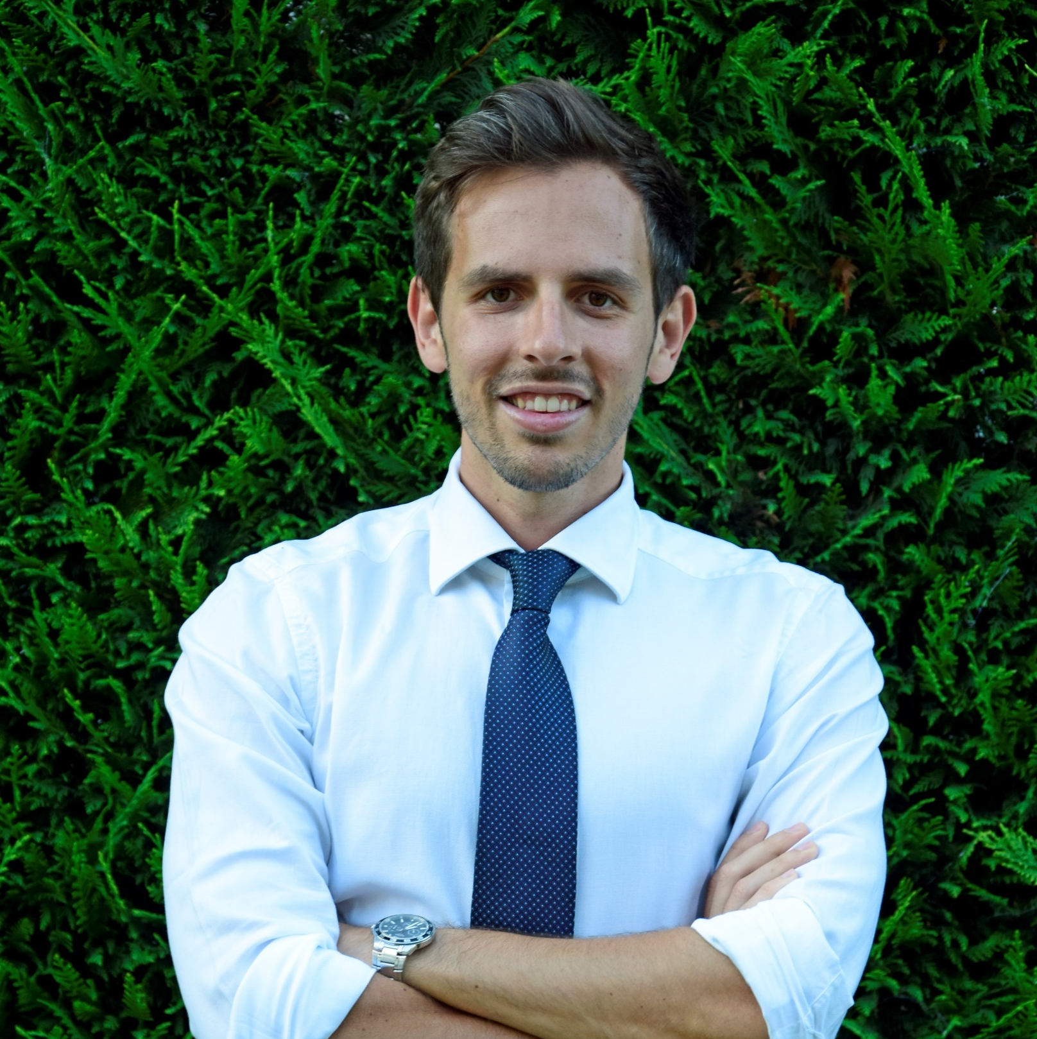
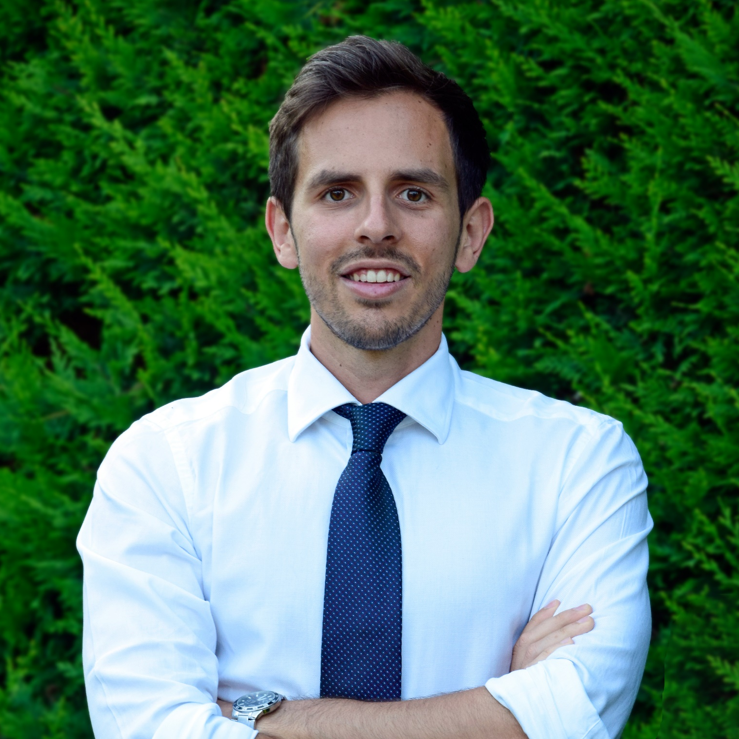
SKILLS
INTERESTS
Adv strategy
Google tools
Seo & sem
DEM strategy
Social media
Travelling
Sport
Tech
Photography
DAVIDE GIAGNACOVO
WORK EXPERIENCE
1992
Business Developer & Marketing Specialist
2017 - 2020
Business Developer & Marketing Specialist
Hitech
▪ Wholesale of hardware and software solutions; ▪ Follow up of customers / prospects to achieve commercial objectives; ▪ Maximization of ROI, through KPI market analysis and SWOT analysis; ▪ Developing strategic marketing plans and advertising budget management; ▪ Identification of new trends and business development opportunities.
Bari
CONTACT
+ 39 392 9493504
Davide.giagnacovo@gmail.com
linkedin.com
2018 - 2020
Business Developer & Inside Sales
Onenet
▪ Realization of commercial offers and interfacing with Poste Italiane commercial;
▪ First customer reference before and after sale;
▪ Building long-term relationships with existing customers;
▪ Communication with the customers for the launching of news promotions;
▪ Management of the technical and commercial theme to manage customer needs;
▪ Cross Selling.
Bari
LANGUAGES
Italian:
English:
French:
2013 - 2014
International Buyer Searcher
Planet consulting
▪ Research companies interested in buying Italian products (UK, Spain, Shanghai etc ...);
▪ InSale Commercial Activity: creation of commercial offers;
▪ Market and competition analysis;
▪ Realization of communication materials through graphic tools;
▪ Native speaker team management for interfacing with foreign customers (4/6 resources);
▪ Training activities for new resources.
Bari
QUALITIES
HARD WORKING / ORGANIZED
RESOURCEFUL / RESPONSIBLE
MOTIVATED/ POSITIVE THINKING
EDUCATION
Master in
Marketing
Bachelor in Marketing and Business Administration
Scientific High School
2014 - 2016
2011 - 2014
2006 - 2011
Uniba - Economics
Uniba - Economics
High School – E. Fermi
www.davidegiagnacovo.com
I hereby authorize the use of my personal details solely for circulation within the company according to the GDPR and the Italian Legislative Decree n° 196/2003. I declare that the above furnished details are true to the best of my knowledge.
VISIT MY WEBSITE

